Slide 1


SDLC Automator
2
+
Revolutionizing Software Development Lifecycle Automation with AI-driven Efficiency and Collaboration

Slide 2

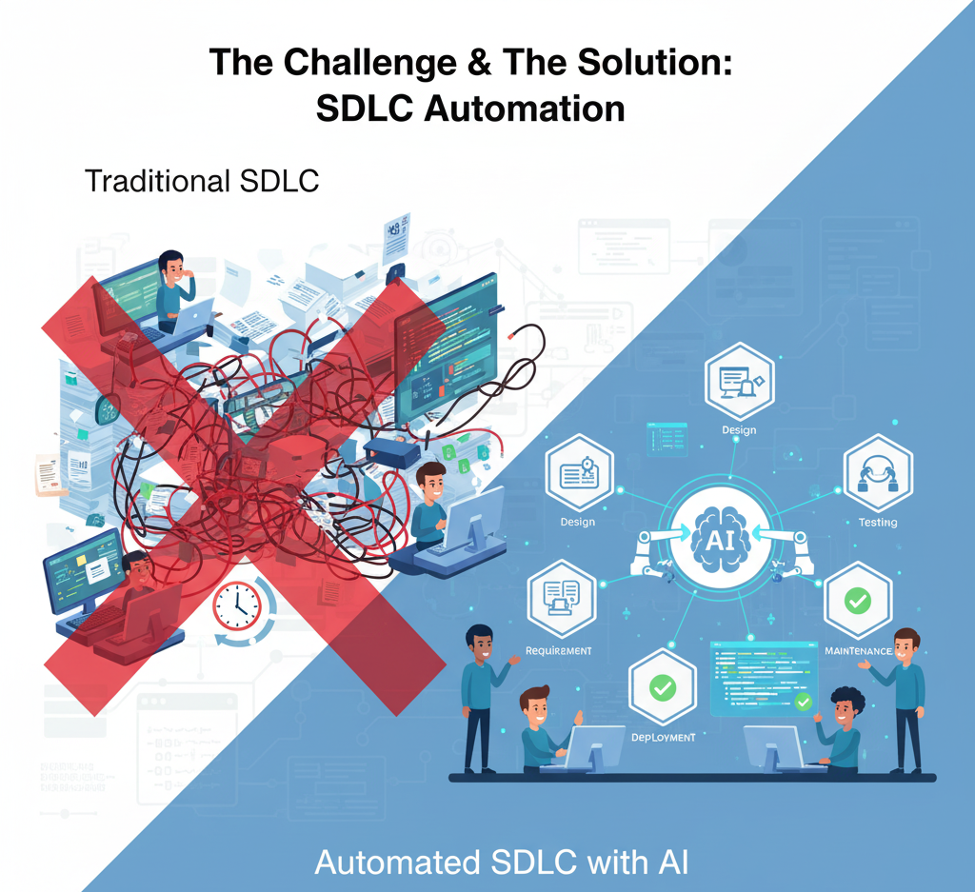

Problem Statement
2
+
In the traditional Software Development Lifecycle (SDLC), one of the most time-consuming and skill-intensive phases is the preparation of documentation. Creating these documents manually requires significant time, domain expertise, and cross-functional collaboration between business analysts, system architects, developers, and QA teams.
2
+
The Pain Points of Manual Documentation

Slide 3

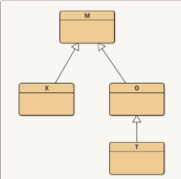



Comprehensive AI-Powered Solution Overview
2
+
Automating SDLC documentation lifecycle with AI-driven accuracy and collaboration
1. Automate full lifecycle of SDLC documents using AI
2. Seamless generation of key SDLC deliverables
3. Integrate visual aids for clarity
4. Unified web-based collaborative interface
5. Boost standardization, accuracy, and productivity
Automatically generate Business Requirement Documents, Software Requirement Specifications, Software Design Documents, Test Cases, and Proposals in a structured workflow.
Use Mermaid charts and diagrams to provide clear, visual representations, improving team understanding.
Utilize AI to fully automate the creation of all SDLC documentation stages.
Centralize access and collaboration through a user-friendly web platform to enhance teamwork and document accuracy.
Drive consistency and reduce errors while improving team productivity through AI-driven automation.
2

Slide 4
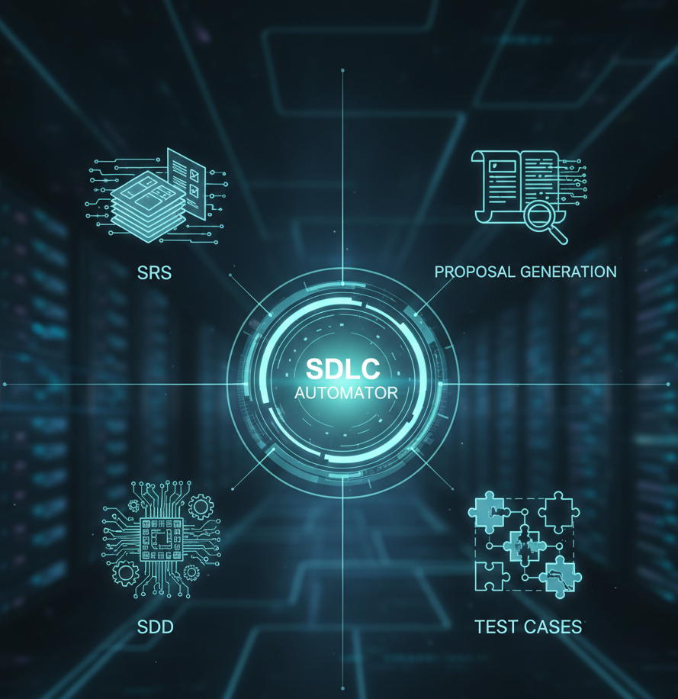
Product Overview: SDLC Automator
2
+
Streamlining the Entire Software Development Lifecycle
SDLC Automator is an AI-powered platform that transforms business requirements into complete, standardized SDLC documents, test cases, proposals, and even code—cutting timelines by up to 85%, eliminating errors, and ensuring compliance. It streamlines the entire software development lifecycle from BRD to deployment, boosting productivity and scalability for modern organizations.
Key Use Cases:
SRS Generation – Automated creation of Software Requirement Specifications
SDD Generation – Structured System Design Documents with diagrams
Test Case Generation – Standardized and ready-to-use test cases
Proposal Generation – Complete proposals for stakeholders
…and more to come – All outputs fully structured with visual diagrams for clarity
3

Slide 5





Target Audience & Market Opportunity
2
+
Identifying key users and stakeholders benefiting from SDLC Automator platform
1. Serve diverse software development organizations
2. Enable streamlined workflows for development teams
3. Support project managers and QA professionals
4. Facilitate IT service providers managing multiple RFPs
5. Address multiple stakeholders in SDLC and delivery
Cater to enterprises, startups, and product companies focused on software development, supporting varied organizational scales and needs.
Provide tools for project managers, business analysts, and QA engineers to ensure traceability, accuracy, and effective project delivery.
Assist software development teams in optimizing and automating their workflows to enhance efficiency and reduce manual efforts.
Help IT service providers efficiently handle multiple client RFPs and proposals through automation and centralized management.
The market opportunity spans a broad range of stakeholders involved throughout the Software Development Life Cycle and project delivery processes.

Slide 6
Key Benefits and Features Overview
2
+
Drive productivity with scalable, secure, and intelligent SDLC documentation automation
End-to-End Automation: Transforms BRDs into complete SRS/SDD documents and RFPs into Proposals, including diagrams, tables, and structured sections.
One-Click Document Generation : Ready-to-use outputs (Word/PDF/Markdown) with visuals + formatting included.
Integrated Visual Aids: Auto-generates diagrams, flowcharts, and tables alongside written documentation.
Compliance & Standardization: Ensures outputs adhere to organizational standards, and regulatory requirements.
Multi-Agent AI Collaboration: Specialized agents handle domain-specific tasks seamlessly.
Reduced Effort & Faster Turnaround: Cuts documentation timelines by 70–80% compared to manual methods.
Error-Free & Consistent Outputs: Eliminates human errors in formatting, structure, and compliance
Seamless RFP-to-Proposal Conversion: Automatically maps client RFPs to proposals with structured responses and visual support.
Scalable & Cloud-Native: Works across multiple projects, RFPs, and large organizations with minimal setup.
feedback-driven outputs: Users can review, give feedback, and alter sections as per choice, ensuring final documents match exact business needs.
5

Slide 7
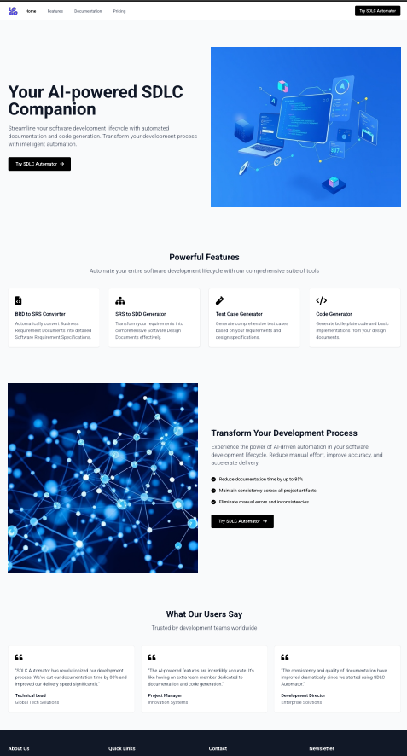
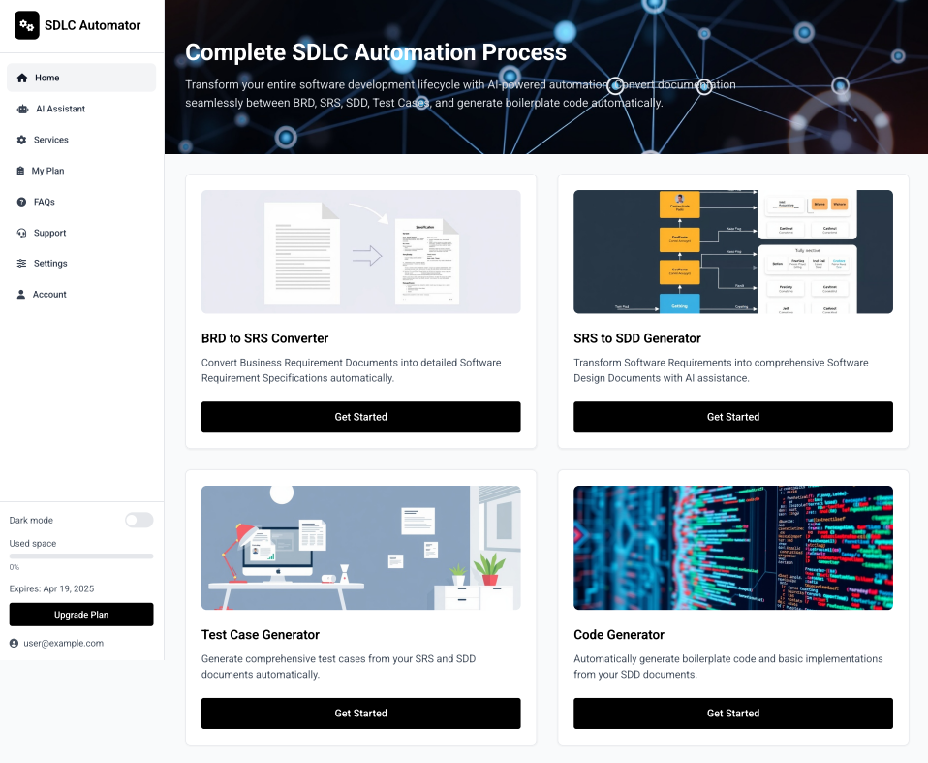
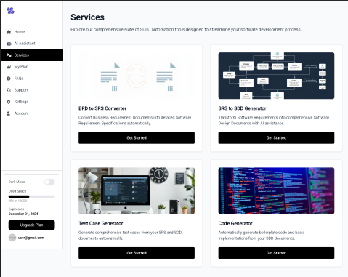
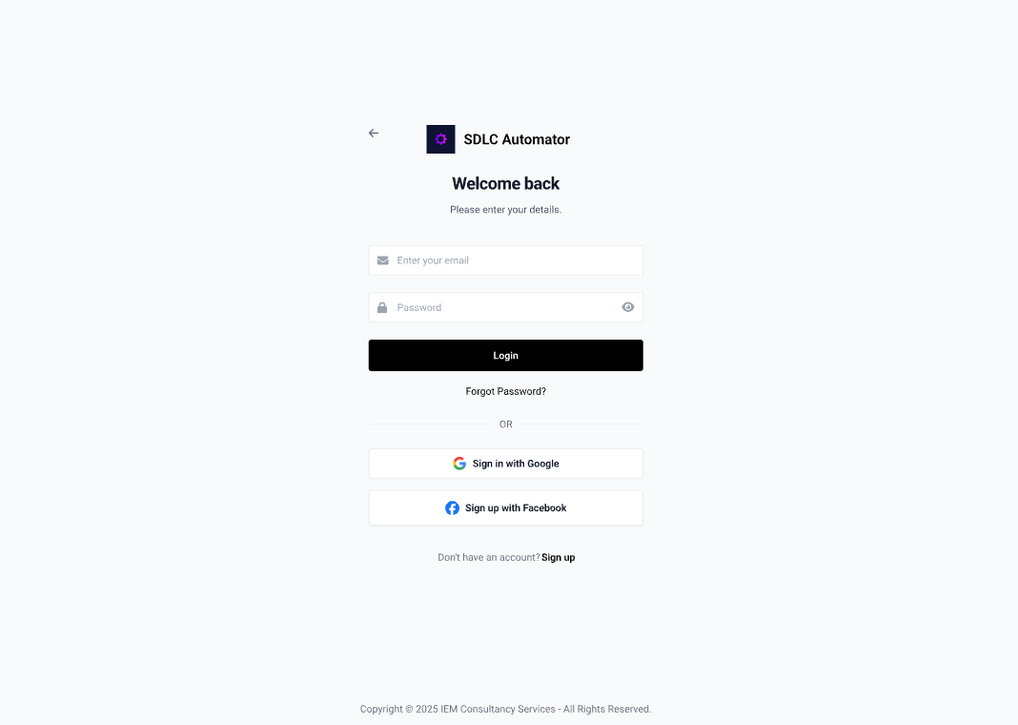
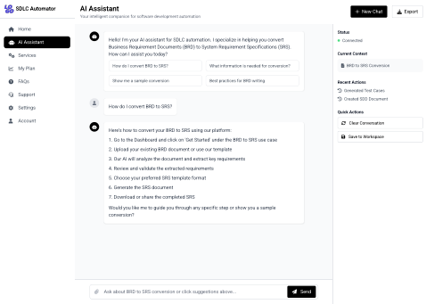
Visual Elements
Dashboard
Services
Landing Page
Login Page
AI Assistant
6

Slide 8
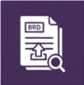
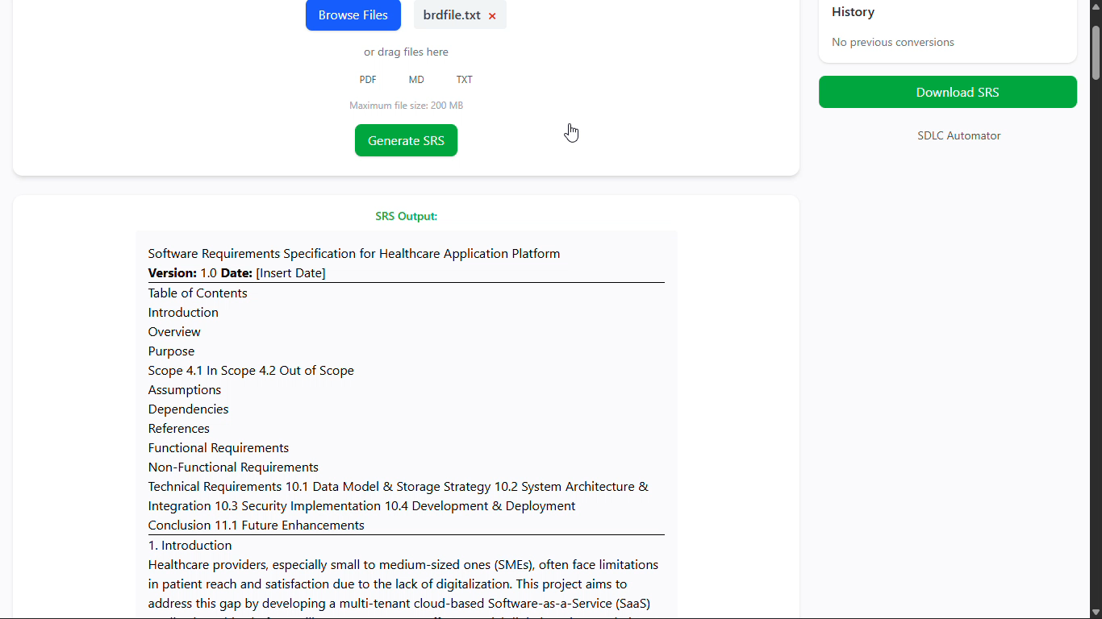



SRS Generation Workflow
2
+
Overview of automated SRS document creation from business requirements
Input Business Requirement Document (BRD)
The system begins with uploading or inputting the BRD which contains project requirements.
AI Extracts Key Requirements Automatically
Artificial intelligence analyzes the BRD to identify and extract essential requirements efficiently.
Generate Standardized SRS Document
Outputs a detailed, standardized Software Requirement Specification with supporting charts, tables, and diagrams.
Ensure Completeness and Consistency
System validates the SRS across projects to maintain thoroughness and uniformity in requirements documentation.
7

Slide 9

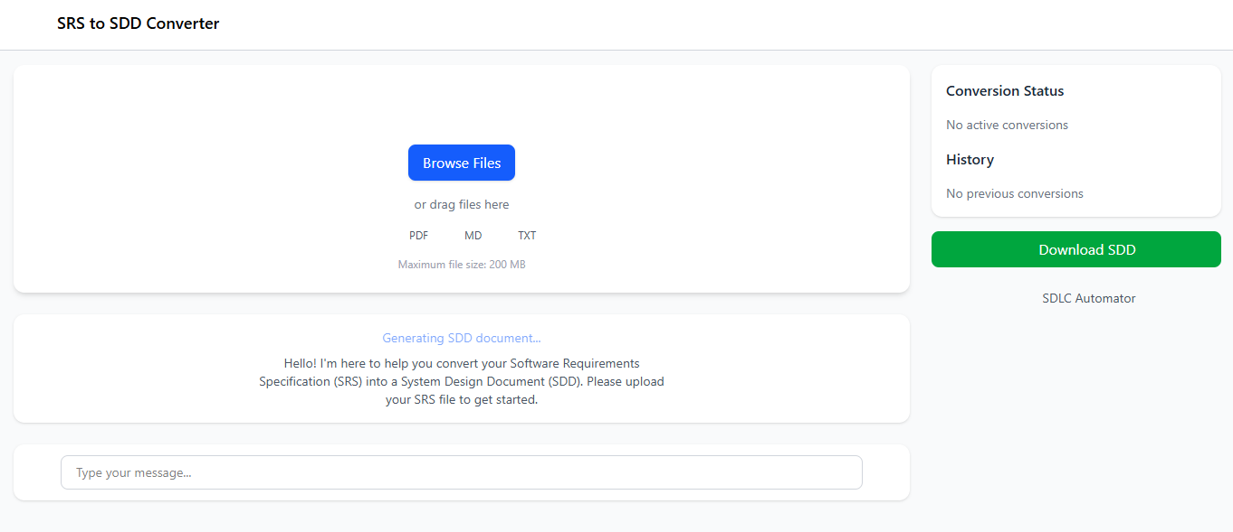

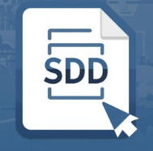

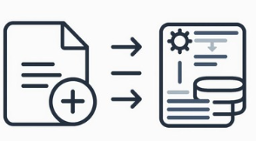
SDD Generation Workflow
2
+
Detailed interface converting SRS documents into comprehensive SDD with visual diagrams
Input SRS Document
Start with the Software Requirements Specification document as the input source.
Convert Requirements to Design Specs
Transform requirements into detailed design specifications for system development.
Generate Complete SDD
Produce System Design Document including system architecture diagrams for clarity.
Auto-integrate Diagrams
Automatically embed diagrams to visually represent design elements clearly.
Generate Final Outputs
Automatically generate two files: a content file with the complete System Design Document and a diagram file containing all architecture and design diagrams.
8

Slide 10
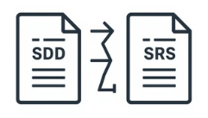
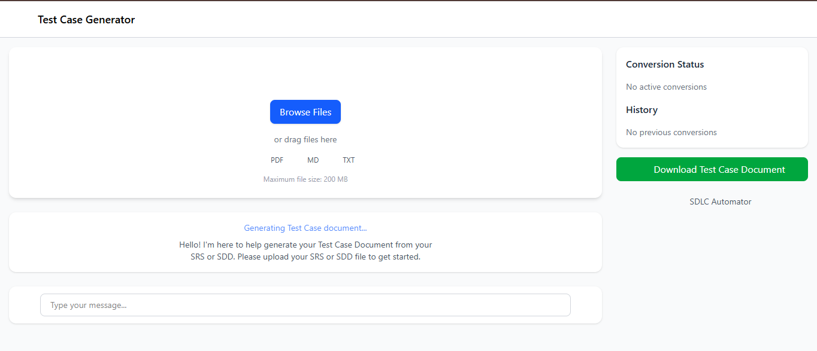



Test Case Generation Workflow
2
+
Overview of automated functional test case creation from requirements
Parse SRS & SDD Documents
The system begins by parsing the Software Requirement Specification (SRS) and System Design Document (SDD) to extract structured functional requirements.
Analyze Requirements Automatically
AI analyzes the extracted requirements to identify test needs for each module or feature, including objectives, scenarios, and edge cases.
Generate Standardized Test Cases
Outputs detailed test cases in a standardized format with clear sections: Test Case ID, Description, Preconditions, Steps, Expected Results, and References (SRS/SDD).
Validate Completeness and Consistency
System validates test cases against the SRS and SDD to ensure full coverage, no duplicates, and alignment with functional requirements.
9

Slide 11
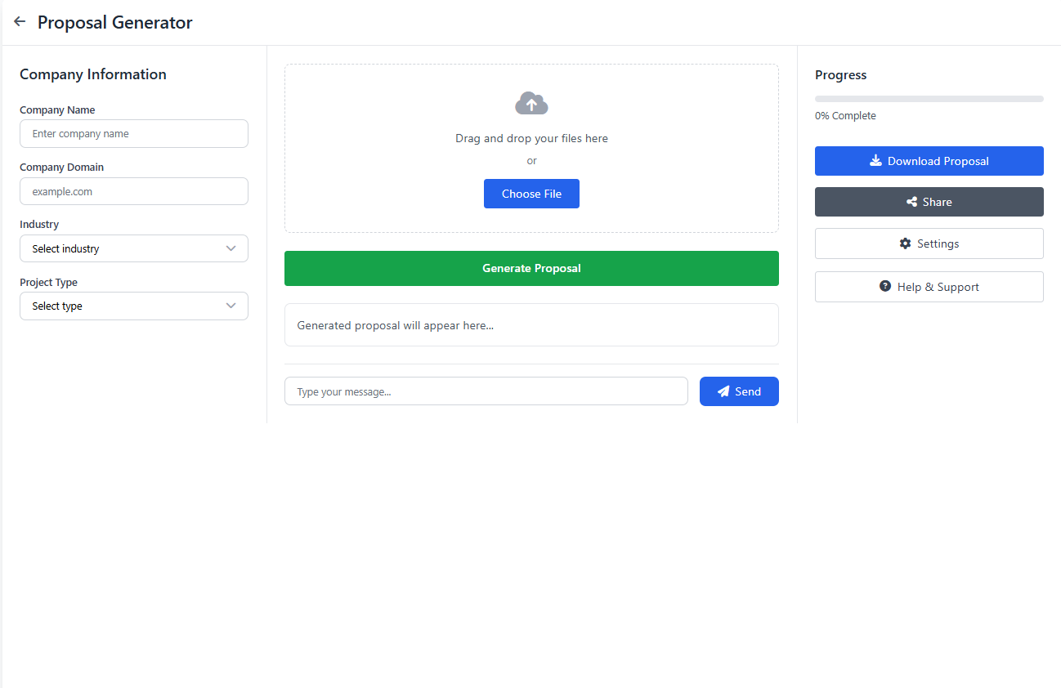
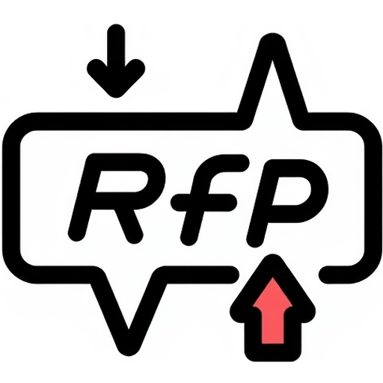
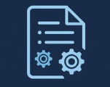

Proposal Generation Workflow
2
+
Automated proposal creation using standardized templates to accelerate delivery and reduce analyst effort
Input Request for Proposal document
Starts with uploading or entering the RFP document to initiate proposal creation
Automatic Proposal Generation
System generates structured proposals including scope, architecture, and solution details automatically
Effort and Time Savings
Significantly reduces business analyst workload and accelerates proposal delivery timelines
10

Slide 12
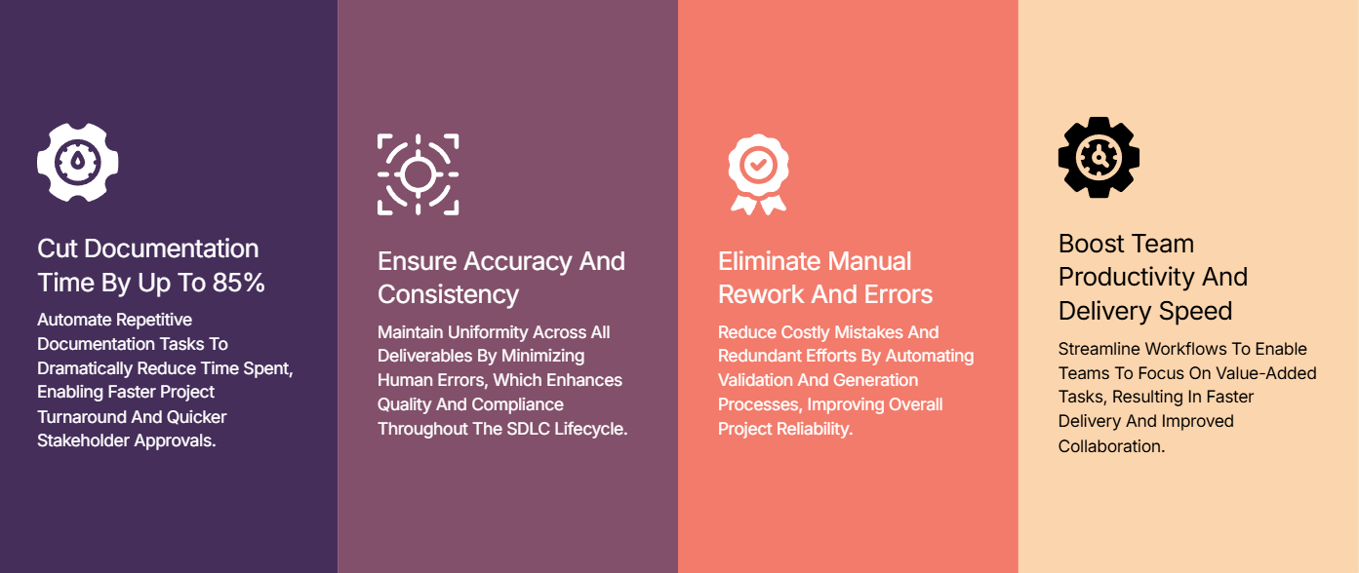
Maximize Efficiency with SDLC Automator
2
+
Accelerate your SDLC processes by reducing errors and boosting team productivity
11

Slide 13
Business Model & Pricing Strategy
2
+
Overview of subscription tiers, add-ons, and scalable solutions supporting growth
Aspect | Details
Business Model | SaaS-based subscription model providing end-to-end SDLC automation. Offers web-based platform for software teams, project managers, and IT service providers.
Target Customers | Software development organizations, IT consultancies, project managers, QA teams, and enterprises managing multiple SDLC projects.
Value Proposition | End-to-end automation of the Software Development Lifecycle — from BRD to SRS to SDD, and from RFPs to proposals — complete with diagrams and charts. It accelerates delivery, minimizes human errors, embeds visual clarity, and fosters seamless collaboration.
Pricing Tiers | 1. Basic: For small teams, limited projects, access to core SDLC automation features. 2. Pro: Medium teams, unlimited projects, advanced automation and diagrams. 3. Enterprise: Custom plans for large organizations, priority support, integrations, and multi-user management.
Revenue Streams | 1. Subscription fees (monthly/annual) 2. Enterprise custom contracts 3. Optional add-ons: advanced templates, integration modules, premium support
Customer Retention Strategy | Regular updates with new features, integration with popular tools, responsive support, and AI-assisted efficiency improvements.
Go-to-Market Strategy | Online marketing, demos for target clients, webinars, partnerships with IT consultancies, and freemium trials to attract new users.
12

Slide 14
Unlock AI-Powered Efficiency with Tailored SDLC Pricing Plans
2
+
Free | Standard | Plus | Enterprise
Features Limited projects (e.g., 1–2) Core SDLC automation (BRD → SRS) Basic diagram generation Community support | Features Up to 5 projects Full SDLC automation (BRD → SRS → SDD) Standard diagrams (UML, flowcharts) Email support | Features Unlimited projects Advanced automation (BRD → SRS → SDD, Proposal) All diagram types + export options Priority email & chat support | Features Unlimited users & projects Custom workflows & integrations Advanced analytics & reporting Premium support
Plan: $0 / month | Plan: $29 / month | Plan: $79 / month | Plan: Custom / quote-based
2
+
Choose the ideal SDLC Automator subscription to accelerate your development workflow and scale with ease.
Note: The pricing and features shown are example/demo values for illustration purposes and may vary in the actual product.

Slide 15
Compare Leading SDLC Automation Platforms Effectively
2
+
Overview of subscription tiers, add-ons, and scalable solutions supporting growth
Feature/Criteria | Our Solution | Competitor A (Traditional ALM / Proposal Tools e.g., Jira, Confluence, RFPIO) | Competitor B (Generic AI Tools e.g., ChatGPT, GitHub Copilot)
Core Offering | End-to-end automation: BRD → SRS → SDD with diagrams + Proposal generation from RFPs | Proposal automation with templates, project tracking, and manual inputs | AI-assisted text generation, but unstructured for RFPs
Automation Level | High - Automated SDLC docs & proposal docs | Medium - Semi-automated proposals, limited SDLC automation | Medium - Can draft proposals but requires manual structuring
Visual Aids (Docs + Diagrams) | Auto-generates UMLs, flowcharts, wireframes alongside proposals | Manual diagrams or third-party plugins | No native diagram/visual support
Learning Curve | Low - guided workflows, automated generation | Medium - requires setup and training | Medium - depends on prompt quality
Cost-Effectiveness | High - 40-68% time savings (reduces documentation from 15-25% to 8-12% of project time) + eliminates manual effort across SDLC | Low - 0-20% savings - tool subscription + high manual resource hours with minimal automation | Medium - 20-30% time savings - but requires significant manual structuring and integration effort, reducing net benefit
Differentiator | Only solution that delivers a complete, formatted, end-to-end SDLC + Proposal document with diagrams, tables, and visuals automatically | Strong tracking/proposal features but weak in automation + completeness | Good content generation but lacks structure, visuals, and lifecycle focus
14

Slide 16
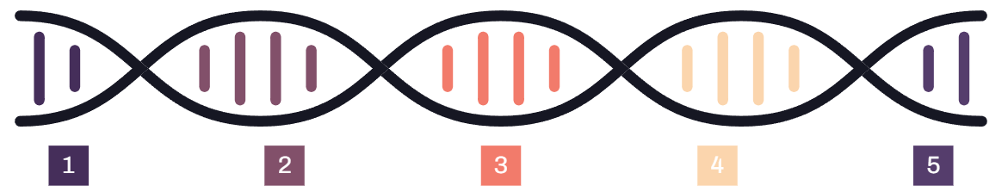
Technology & Innovation Stack
2
+
Core Technologies Powering SDLC Automator’s Innovation and Extensibility
Gemini API as foundational LLM
Agentic AI frameworks: CrewAI and LangGraph
Mermaid tool for diagrams
Web-based UI for accessibility
Technology foundation ensures innovation
Provides the base large language model enabling intelligent language processing and generation.
Generates charts and diagrams to visualize workflows and processes effectively.
Ensures seamless workflow automation with easy access and user-friendly interface.
Enable intelligent automation through agent-based AI orchestration and workflow management.
Supports extensibility and continuous platform enhancement for evolving SDLC needs.
15

Slide 17




Market Positioning & Competitive Advantage
2
+
Unique Selling Proposition and Differentiation in SDLC Automation
1. Lead with first-of-its-kind AI-powered SDLC automation
2. Provide comprehensive lifecycle coverage from BRD to code
3. Deliver high accuracy, consistency, and scalability via SaaS
4. Maintain clear leadership with no direct full lifecycle competitors
The platform offers an end-to-end AI-powered automation solution uniquely covering the software development lifecycle, setting a new industry standard.
Plans include full coverage starting from Business Requirements Document (BRD) to automatic code generation, ensuring seamless and integrated development automation.
The SaaS model enables scalable deployment with consistent, precise output, enhancing operational efficiency across teams and projects.
Currently, no other competitors offer a fully integrated solution covering the entire SDLC automation lifecycle, securing a unique market position.
16

Slide 18




Upcoming Use Cases and Future Development Roadmap
2
+
Transforming Software Development Lifecycle with AI Automation to Enhance Efficiency and Risk Management
BRD Analyzer : Automatically audit Business Requirement Documents (BRDs)
Identify missing sections, inconsistencies, and compliance issues while providing a detailed gap analysis report for proactive corrections.
RFP Checker : Validate Requests for Proposal (RFPs) for completeness
Check RFPs for structure, compliance, and gaps, delivering actionable recommendations to enhance procurement and vendor engagement processes.
Automated Code Generation: Generate production-ready code from design documents
Automatically produce code from SDD wireframes, mockups, and design descriptions with preview support to accelerate coding phases and reduce manual errors.
Traceability Matrix Generation : Generate end-to-end requirement traceability matrix
Create traceability across BRD, SRS, and SDD to ensure complete coverage, alignment, and strengthen requirement validation and impact analysis.
17

Slide 19




Our Team
2
+
Discover the passionate experts fueling creativity, dedication, and excellence in every project
Name: Prof. Dr Amit Kumar Das Role: Mentor
Name: Biswajit Chaki Role: Solution Architect
Name: Jigisha Basu Role: Team Lead & Project Manager
Name: Aritra Mukhopadhyay Role: Developer
Name: Jyotiraditya Ray Role: Developer
Name: Raunak Mishra Role: Developer
18

Slide 20

THANK YOU
2
+
2
+

